Slide 1
Cold War Geopolitics and Great Game by Great Powers in 1971

Slide 2
To any Bangladeshi populace there are some stereotype answers about the causes for the emergence of Bangladesh in 1971. Most citizens would argue that the discrimination between the Bengali and non-Bengali population was responsible for the disintegration of the two wings within a short span of 23 years of statehood.

Slide 3
Geopolitics
Cold War
Sino-Soviet Conflicts
Sino-Indian Rivalry
Nuclear powers Competition

Slide 4
Great and super powers in the emergence of Bangladesh
India claimed that her involvement in the Bangladesh crisis was due to the influx of “ten million” refugees.
Security scenarios that persisted between 1947-1953 led Pakistan to usher a new era of close alignment with the United States. Pakistan concluded a Muslim Defense Assistance Agreement with the USA on May 19, 1954.
Pakistan received economic and military aid from the big and super powers.
In 1955, Pakistan signed another US-sponsored pact of mutual cooperation with Turkey, Iraq, and Great Britain and Iran, which become as the Baghdad Pact. It was later renamed as the Central Treaty Organization (CENTO) in 1958.

Slide 5
What role did the Soviet Union play during the 1971 crisis?
Polarized world system ( USA vs. Soviet Union)
Decolonization
Cold War ( Capitalist vs. Socialist blocks/USA vs. USSR)
Vietnam war
War in the Korean peninsula
Non-aligned Movement ( by India’s Nehru and others )

Slide 6
The Liberation War of Bangladesh was seen by the Indian policy makers as a prime time to dismember Pakistan. By the creation of Bangladesh, they pondered: (a) the political enemy on both its borders would be replaced by a far weaker enemy on one side and a friend on the other; (b) secularism would be regarded as a dominant ideology for the developing countries; (c) India would emerge as an Asian superpower; (d) India would establish a subservient government in Bangladesh; (e) Bangladesh would be an extension of the Indian market; (f) India would materialize the Nehruvian vision of the Greater Indian Union.
India’s interest and involvement in political happenings in East Pakistan during 1969-70 were closely linked with her constantly tense and bad relations with Pakistan.

Slide 7
Machiavelli said, “Enemy’s enemy is my friend”.
China has border disputes with India. Also China has historic claim to the Arunachal Pradesh of India (Shahriar, 2020).
India and Pakistan have disputed claims over Jammu and Kashmir

Slide 8
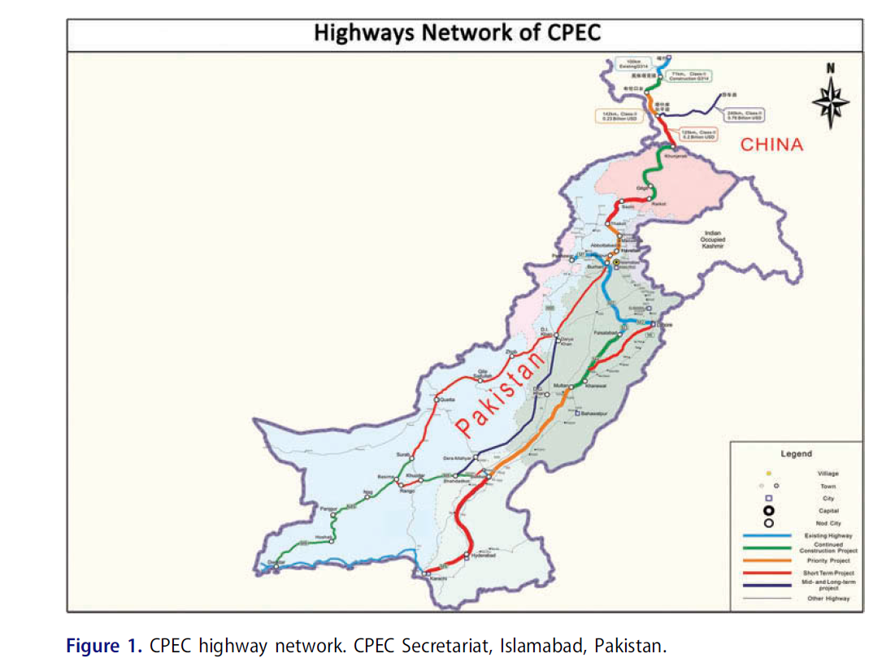

Slide 9
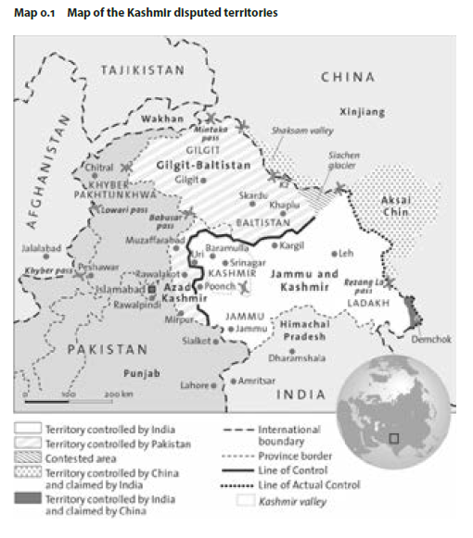

Slide 10
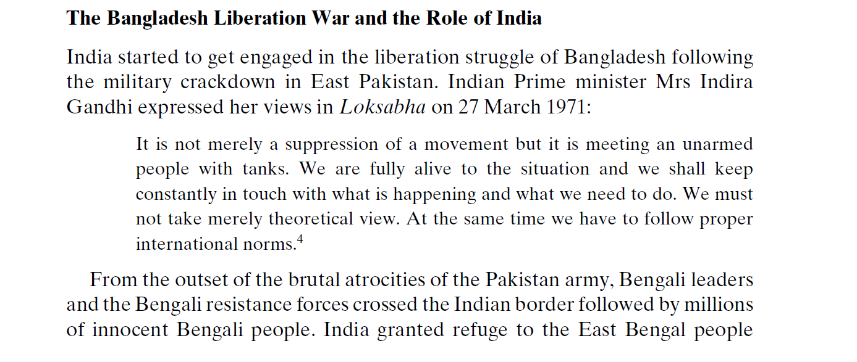

Slide 11
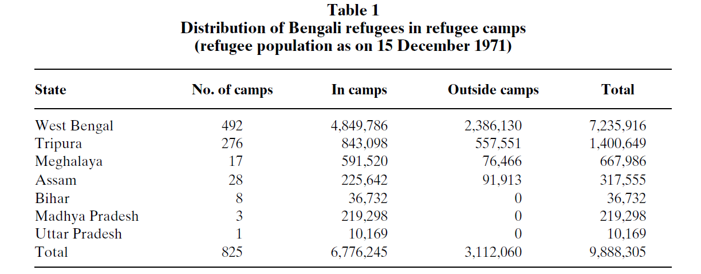

Slide 12
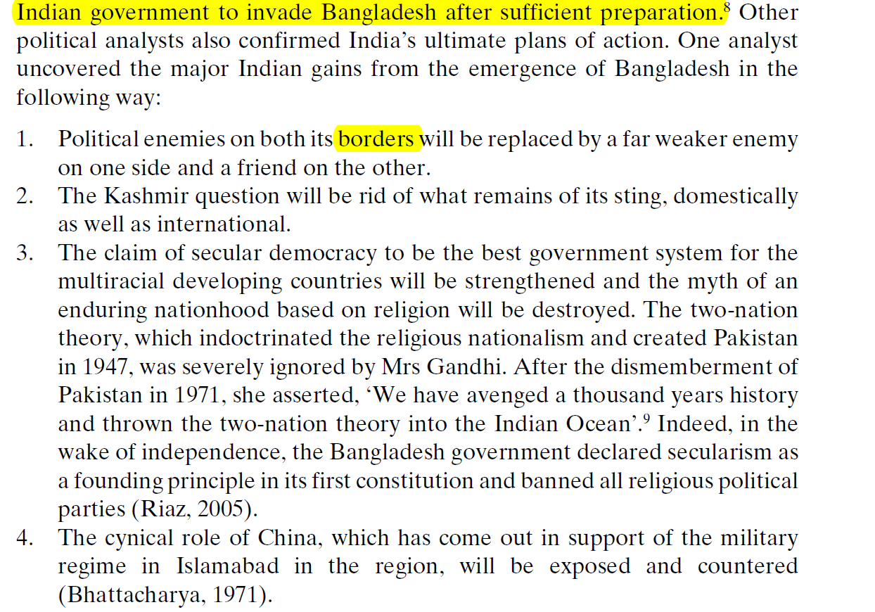

Slide 13
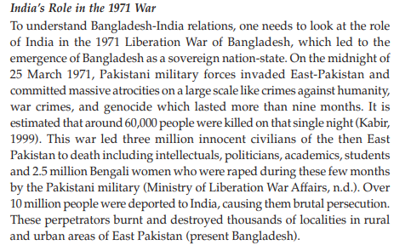

Slide 14
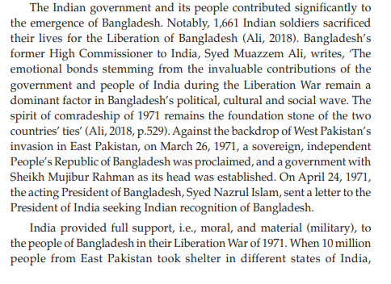

Slide 15
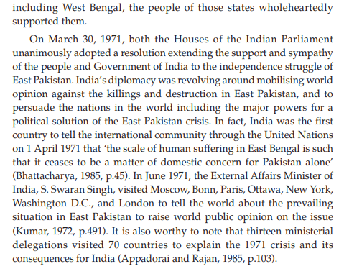

Slide 16
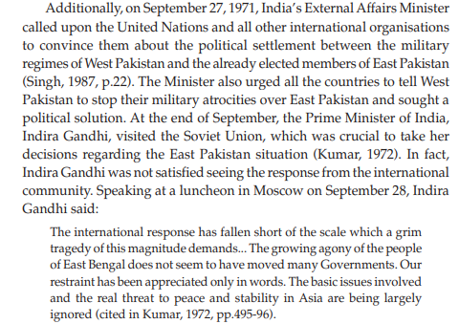

Slide 17
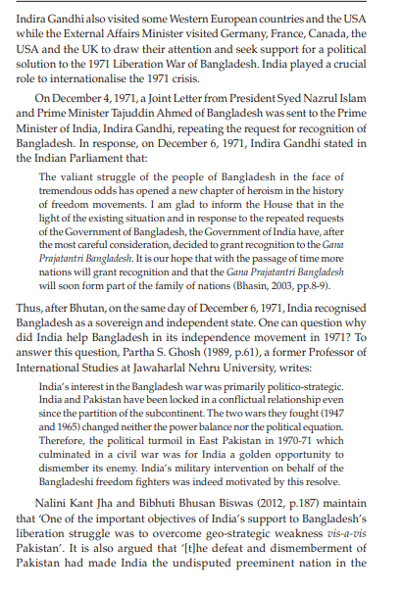

Slide 18
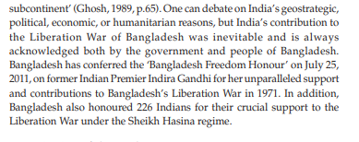

Slide 19
Super power rivalry
Nixon administration
SEATO & CENTO Pact
Kashmir issue
U.S. role/Nixon Administration
Indian assistance
Political Leadership
Awami League

